Slide 1
Data Preprocessing
Dr. Gede Angga Pradipta S.T.,M.Eng

Slide 2
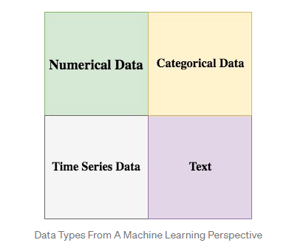
Type of Data
Most data can be categorized into 4 basic types from a Machine Learning perspective: numerical data, categorical data, time-series data, and text.

Slide 3
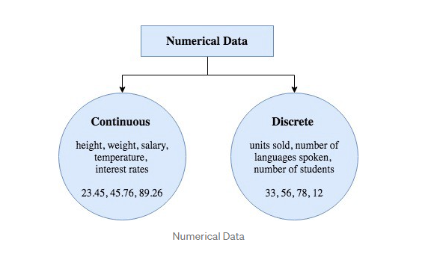
Numerical Data
Numerical data is any data where data points are exact numbers. Statisticians also might call numerical data, quantitative data. This data has meaning as a measurement such as house prices or as a count, such as a number of residential properties in Los Angeles or how many houses sold in the past year.
Numerical data can be characterized by continuous or discrete data. Continuous data can assume any value within a range whereas discrete data has distinct values.

Slide 4
Categorical Data
Categorical data represents characteristics, such as a hockey player’s position, team, hometown. Categorical data can take numerical values. For example, maybe we would use 1 for the colour red and 2 for blue. But these numbers don’t have a mathematical meaning. That is, we can’t add them together or take the average.
In the context of super classification, categorical data would be the class label. This would also be something like if a person is a man or woman, or property is residential or commercial.

Slide 5
Ordinal Data
There is also something called ordinal data, which in some sense is a mix of numerical and categorical data.
In ordinal data, the data still falls into categories, but those categories are ordered or ranked in some particular way.
An example would be class difficulty, such as beginner, intermediate, and advanced. Those three types of classes would be a way that we could label the classes, and they have a natural order in increasing difficulty.

Slide 6
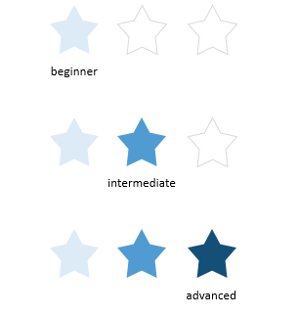
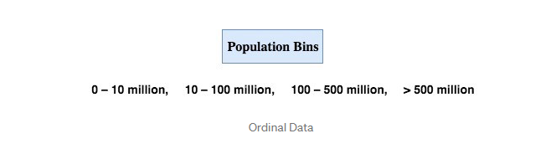
Ordinal Data

Slide 7
Time Series Data
Time series data is a sequence of numbers collected at regular intervals over some period of time. It is very important, especially in particular fields like finance. Time series data has a temporal value attached to it, so this would be something like a date or a timestamp that you can look for trends in time.
For example, we might measure the average number of home sales for many years. The difference of time series data and numerical data is that rather than having a bunch of numerical values that don’t have any time ordering, time-series data does have some implied ordering. There is a first data point collected and the last data point collected.

Slide 8
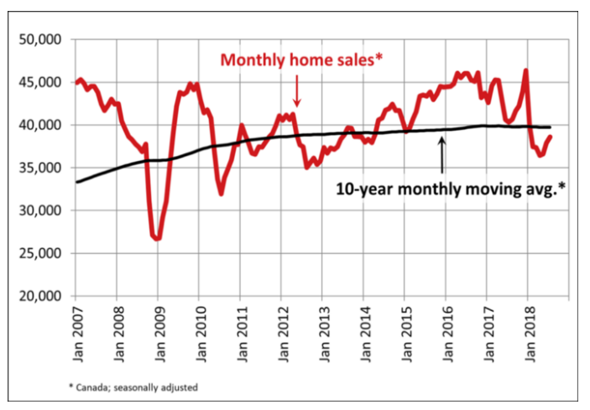
Time Series Data

Slide 9

TEXT
Text data is basically just words. A lot of the time the first thing that you do with text is you turn it into numbers using some interesting functions like the bag of words formulation.

Slide 10
Data Quality: Why Preprocess the Data?
Data have quality if they satisfy the requirements of the intended use. There are many factors comprising data quality, including accuracy, completeness, consistency, timeliness, believability, and interpretability.
In other words, the data you wish to analyze by data mining techniques are incomplete (lacking attribute values or certain attributes of interest, or containing only aggregate data); inaccurate or noisy (containing errors, or values that deviate from the expected); and inconsistent (e.g., containing discrepancies in the department codes used to categorize items).

Slide 11
Inaccurate data
The data collection instruments used may be faulty
There may have been human or computer errors occurring at data entry
Users may purposely submit incorrect data values for mandatory ﬁelds when they do not wish to submit personal information (e.g., by choosing the default value “January 1” displayed for birthday)
Errors in data transmission can also occur.
Incorrect data may also result from inconsistencies in naming conventions or data codes, or inconsistent formats for input ﬁelds (e.g., date)

Slide 12
Incomplete Data
Attributes of interest may not always be available, such as customer information for sales transaction data
Other data may not be included simply because they were not considered important at the time of entry
Relevant data may not be recorded due to a misunderstanding or because of equipment malfunctions

Slide 13
Major Task in Preprocessing Data
Gathering the data
Import the dataset & Libraries
Divide the dataset into Dependent & Independent variable
Check for missing values
Check for Categorical values
Split the dataset into training and test set
Feature Scaling

Slide 14
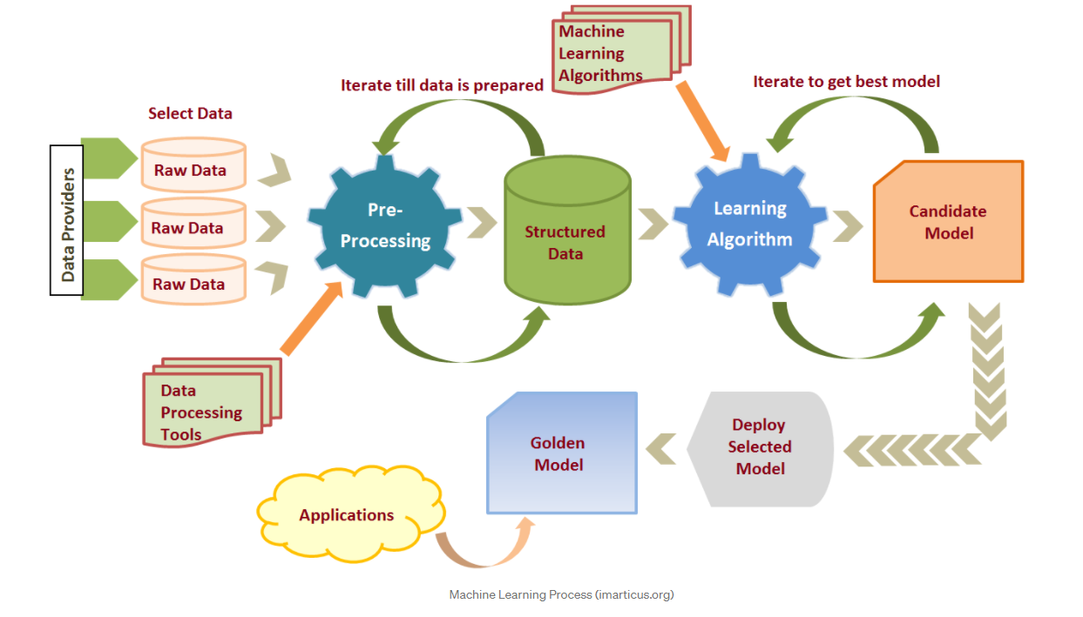

Slide 15
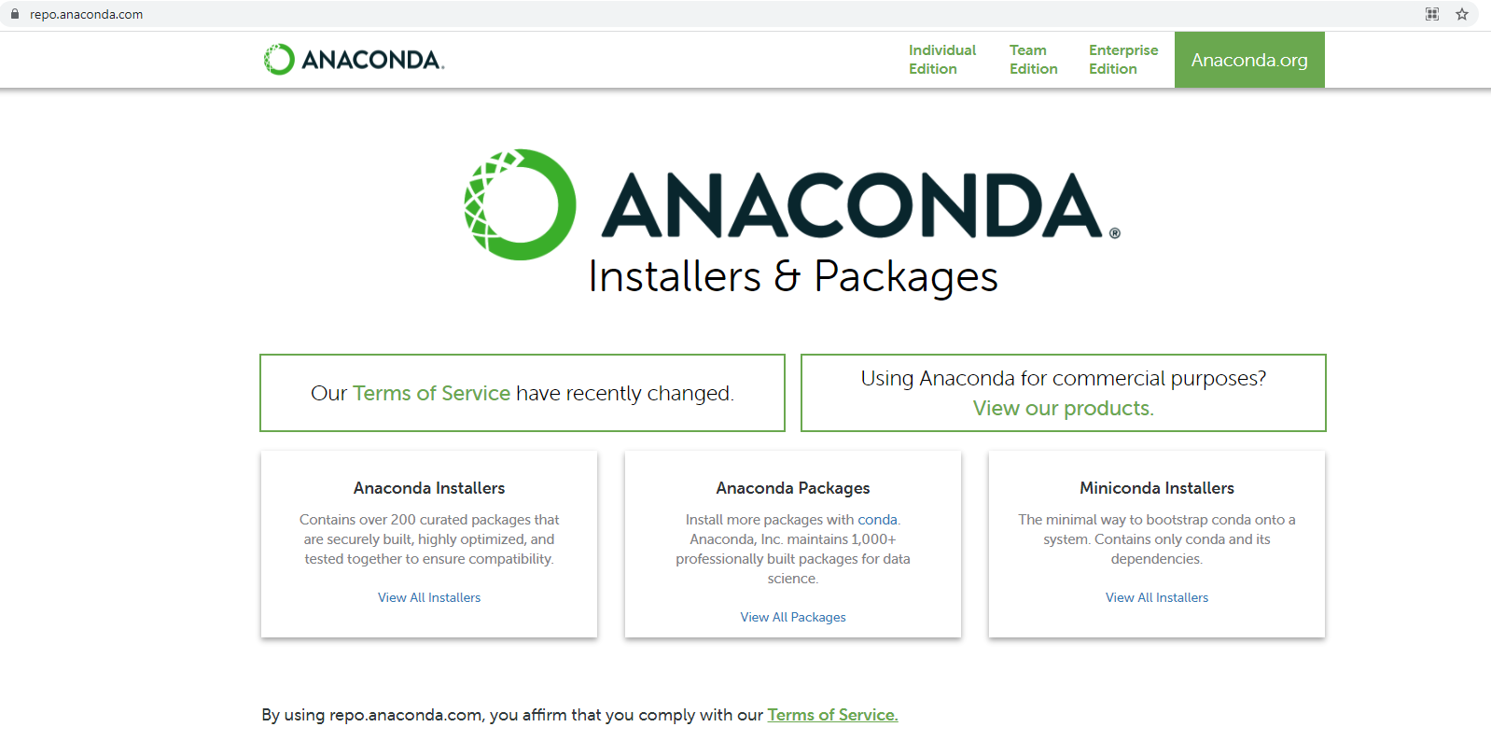
How to Install Anaconda, Jupyter Notebook, and Jupyter Notebook Online (google colab)
Anaconda
Download link : https://repo.anaconda.com/
Klik view all installers

Slide 16
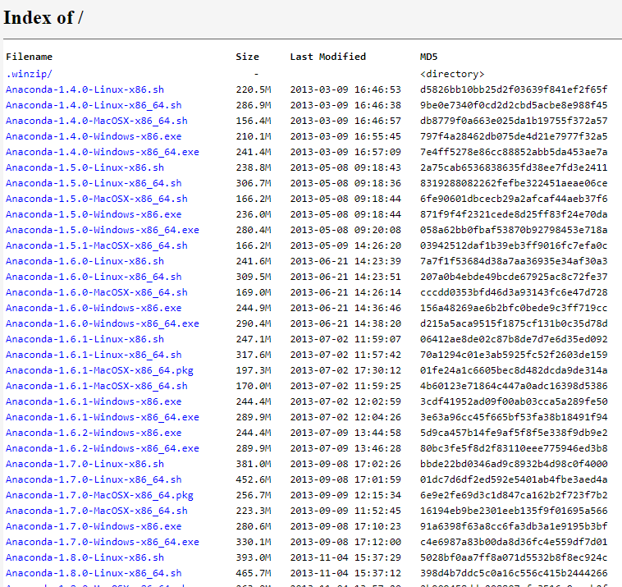
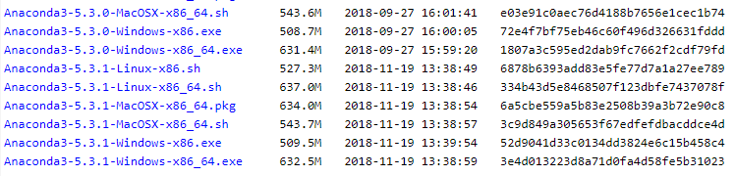
How to Install Anaconda, Jupyter Notebook, and Jupyter Notebook Online (google colab)
Pilih versi last modified terbaru dan khusus untuk OS windows

Slide 17
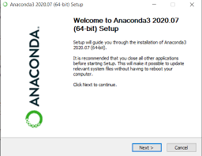
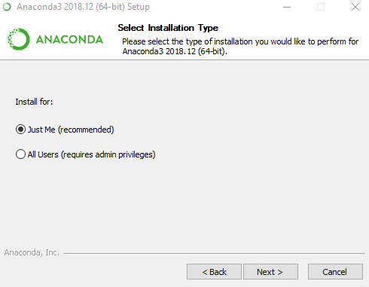
How to Install Anaconda, Jupyter Notebook, and Jupyter Notebook Online (google colab)
1
3
2
4

Slide 18
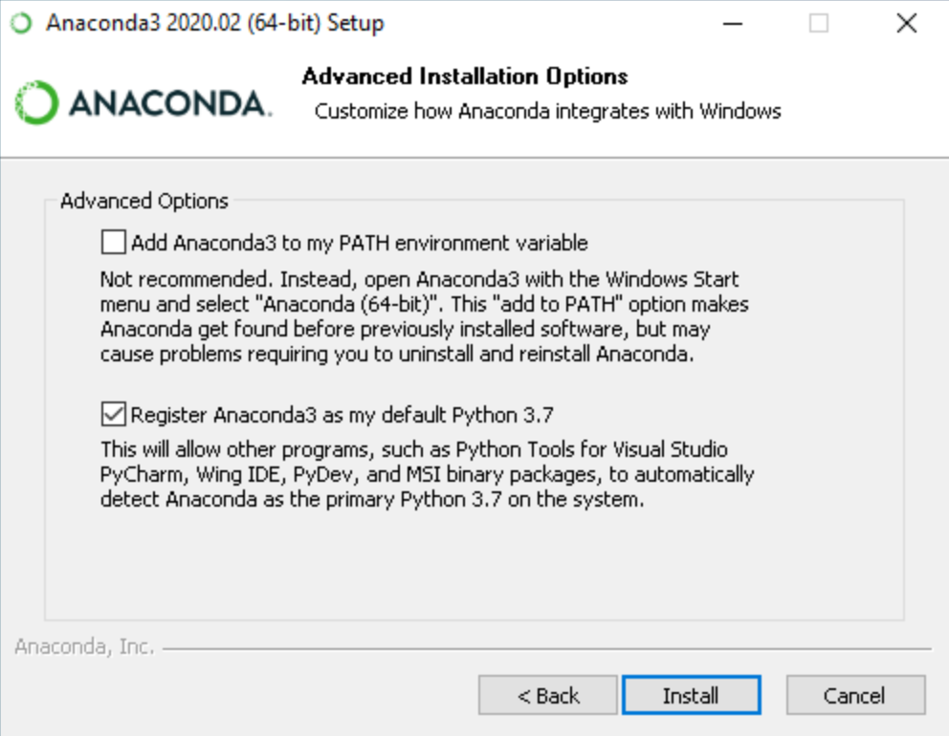
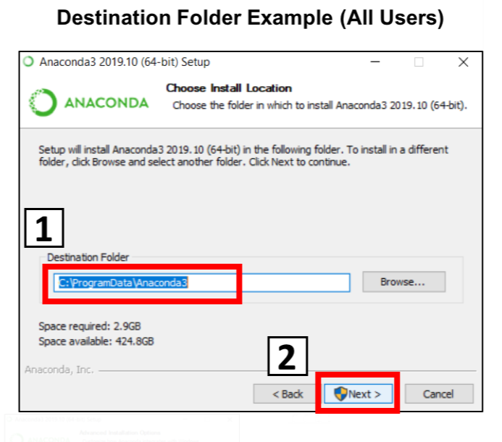
How to Install Anaconda, Jupyter Notebook, and Jupyter Notebook Online (google colab)
5
6

Slide 19
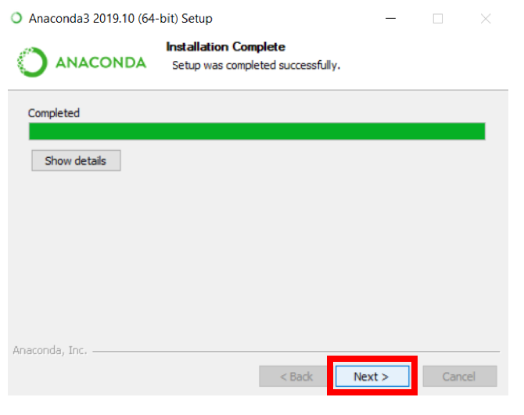
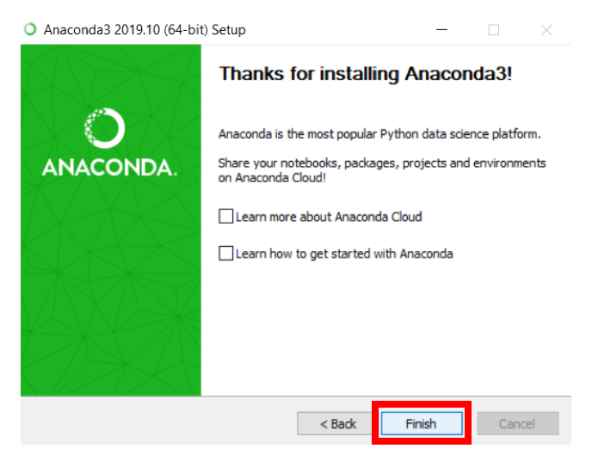
How to Install Anaconda, Jupyter Notebook, and Jupyter Notebook Online (google colab)

Slide 20
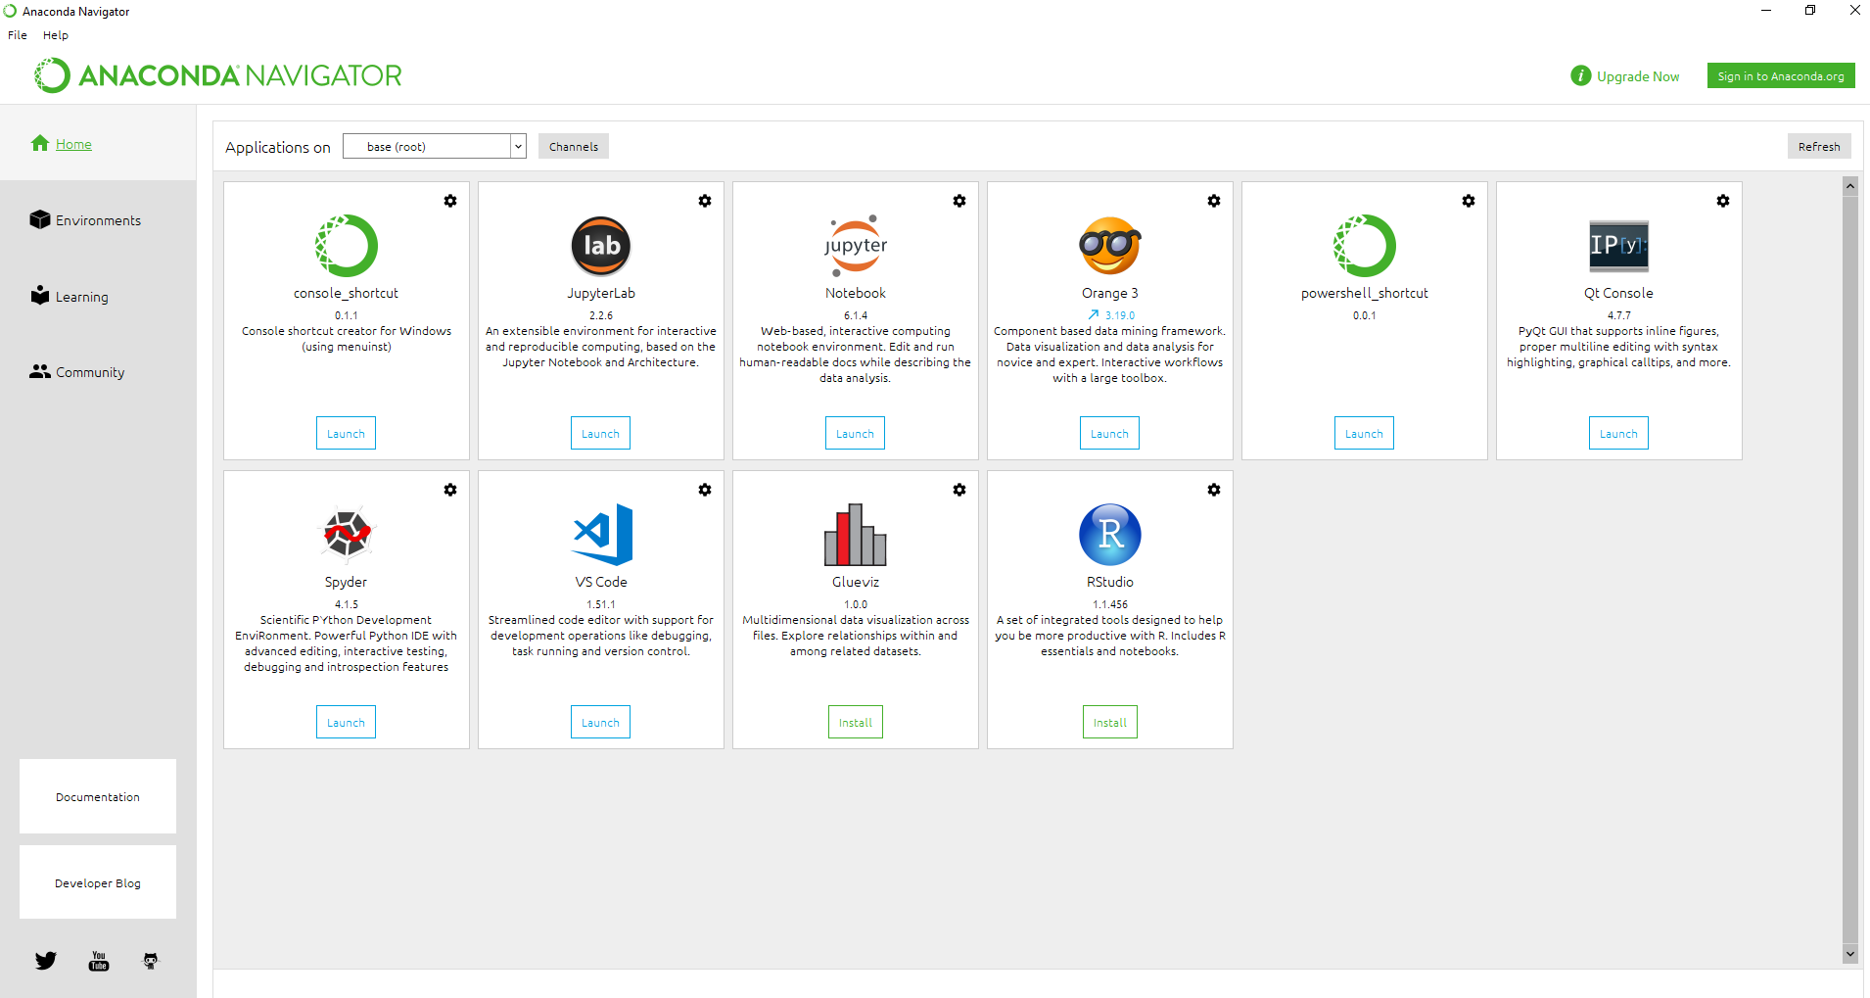
How to Install Anaconda, Jupyter Notebook, and Jupyter Notebook Online (google colab)
Search anaconda navigator di program file windows setelah proses instalasi selesai.

Slide 21
How to Install Anaconda, Jupyter Notebook, and Jupyter Notebook Online (google colab)
Persiapkan folder yang akan digunakan untuk direktori kerja. Misalnya di E:\Dataminig. Buat lewat file explorer

Slide 22
How to Install Anaconda, Jupyter Notebook, and Jupyter Notebook Online (google colab)
Klik Environment Pada Anaconda Navigator

Slide 23
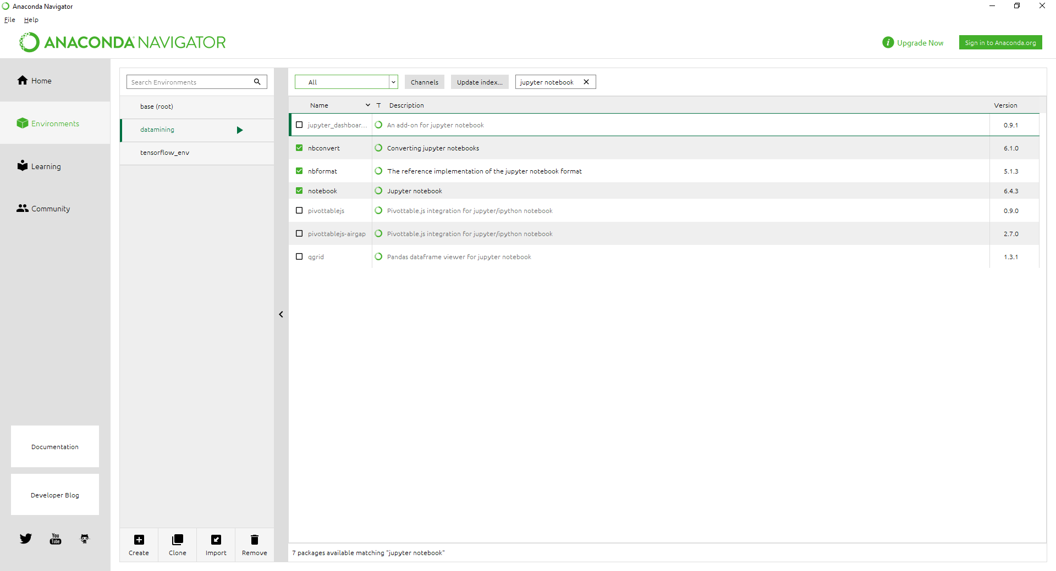
How to Install Anaconda, Jupyter Notebook, and Jupyter Notebook Online (google colab)
Buat environment baru dengan klik symbol create

Slide 24
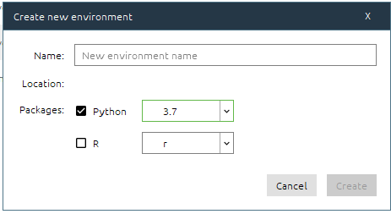
How to Install Anaconda, Jupyter Notebook, and Jupyter Notebook Online (google colab)
Beri nama
Ganti menjadi Python versi 3.7

Slide 25
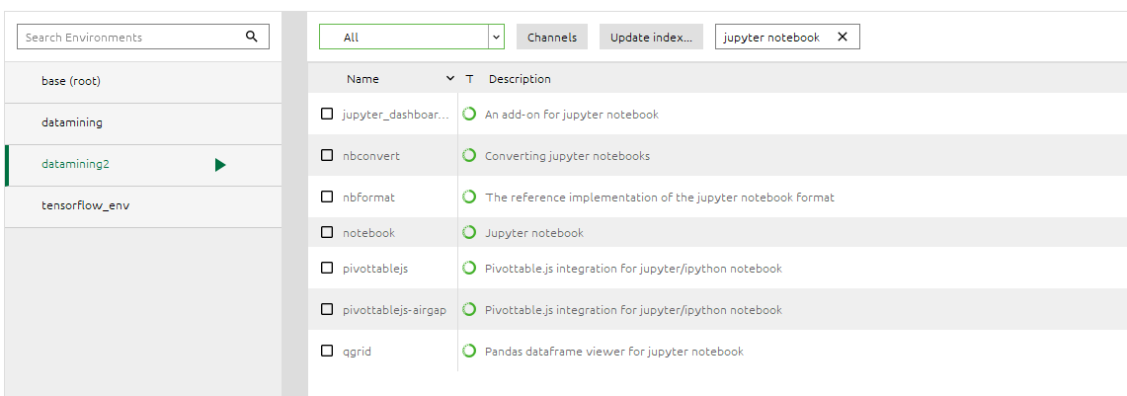
How to Install Anaconda, Jupyter Notebook, and Jupyter Notebook Online (google colab)
Environment baru yang dibuat sudah muncul

Slide 26
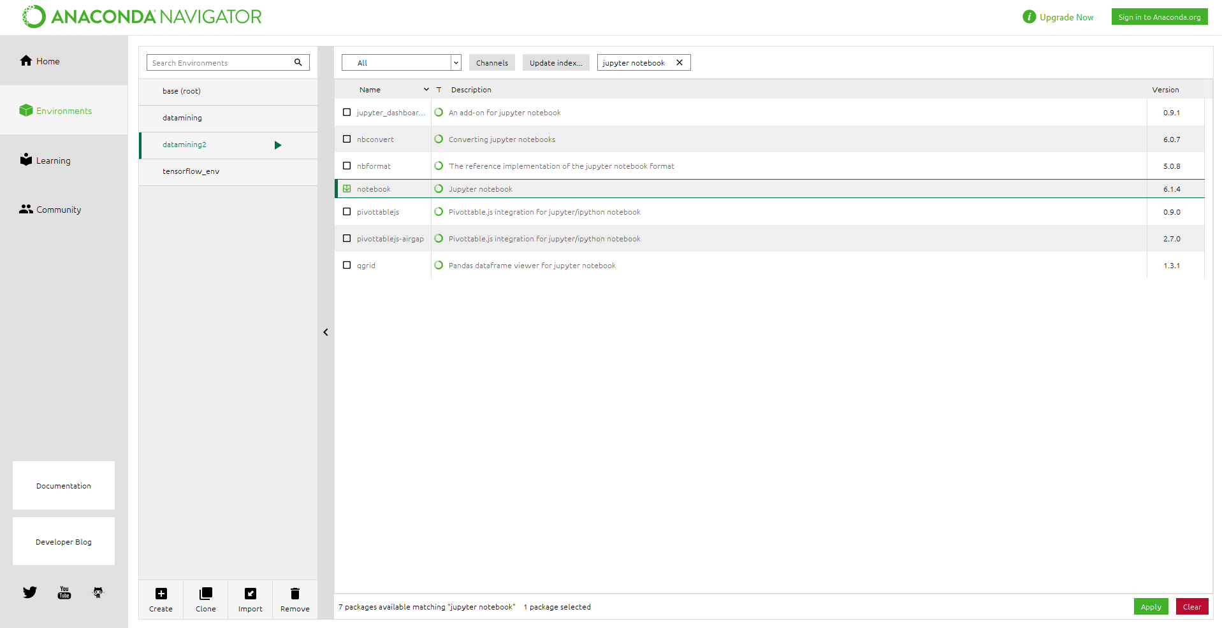
How to Install Anaconda, Jupyter Notebook, and Jupyter Notebook Online (google colab)
Ketik jupyter notebook pada kolom pencarian
Pilih all
Centang jupyter notebook hasil pencarian
Setelah selesai klik apply

Slide 27
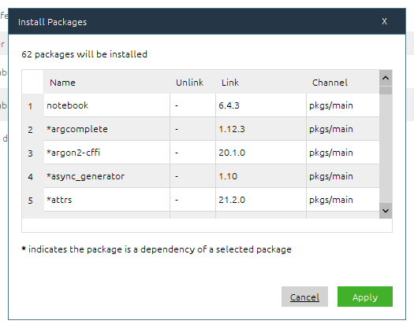
How to Install Anaconda, Jupyter Notebook, and Jupyter Notebook Online (google colab)
klik apply untuk install paket notebook

Slide 28
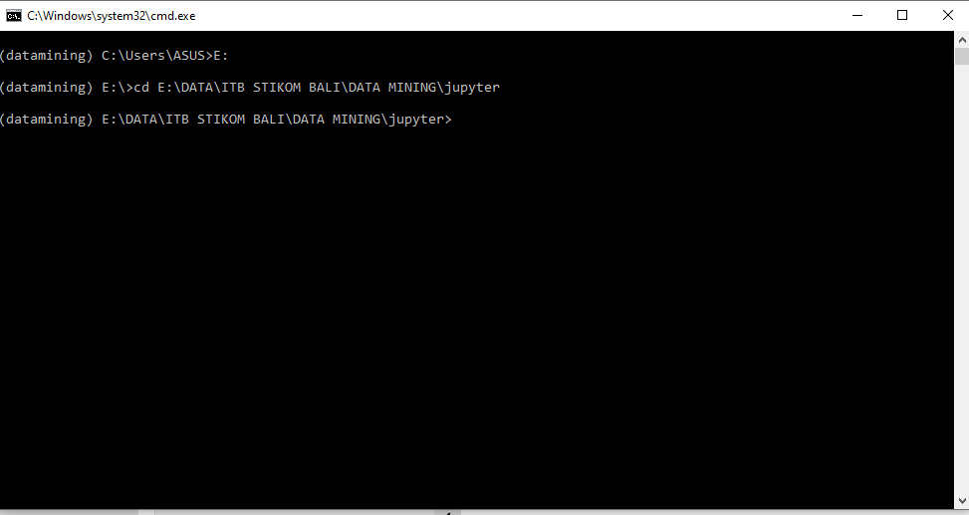

How to Install Anaconda, Jupyter Notebook, and Jupyter Notebook Online (google colab)
klik button play pada environment lalu klik open terminal
Pada terminal indah ke direktori kerja yang telah dibuat sebelumnya.
Contoh :
Ketik -> E:
Kemudian pindah ke folder
cd E:\DATA\ITB STIKOM BALI\DATA MINING\jupyter

Slide 29
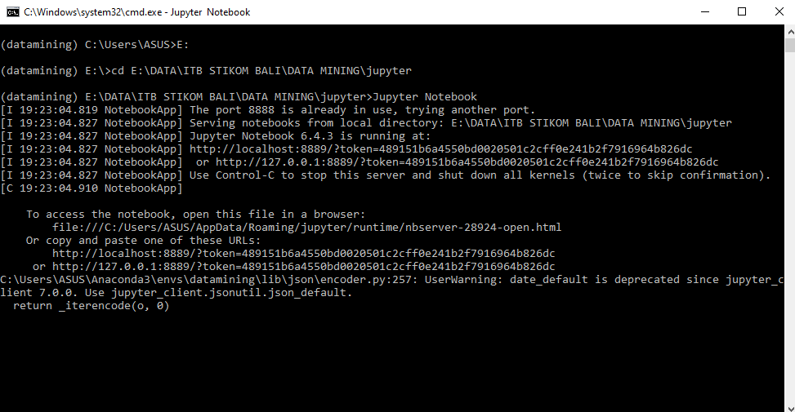
How to Install Anaconda, Jupyter Notebook, and Jupyter Notebook Online (google colab)
Jika sudah pindah ke direktori kerja maka Ketik Jupyter Notebook untuk menghidupkannya.
tunggu hingga jupyter notebook muncul di browser

Slide 30
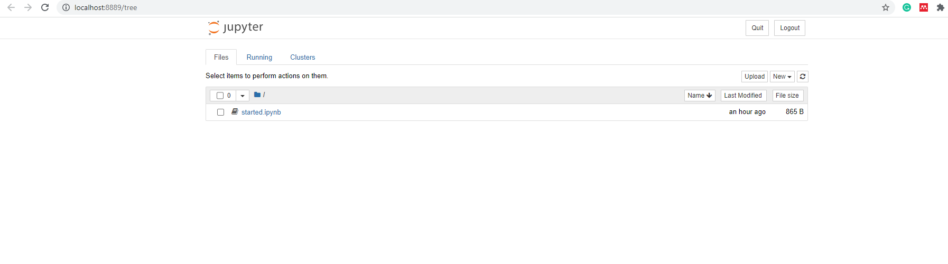
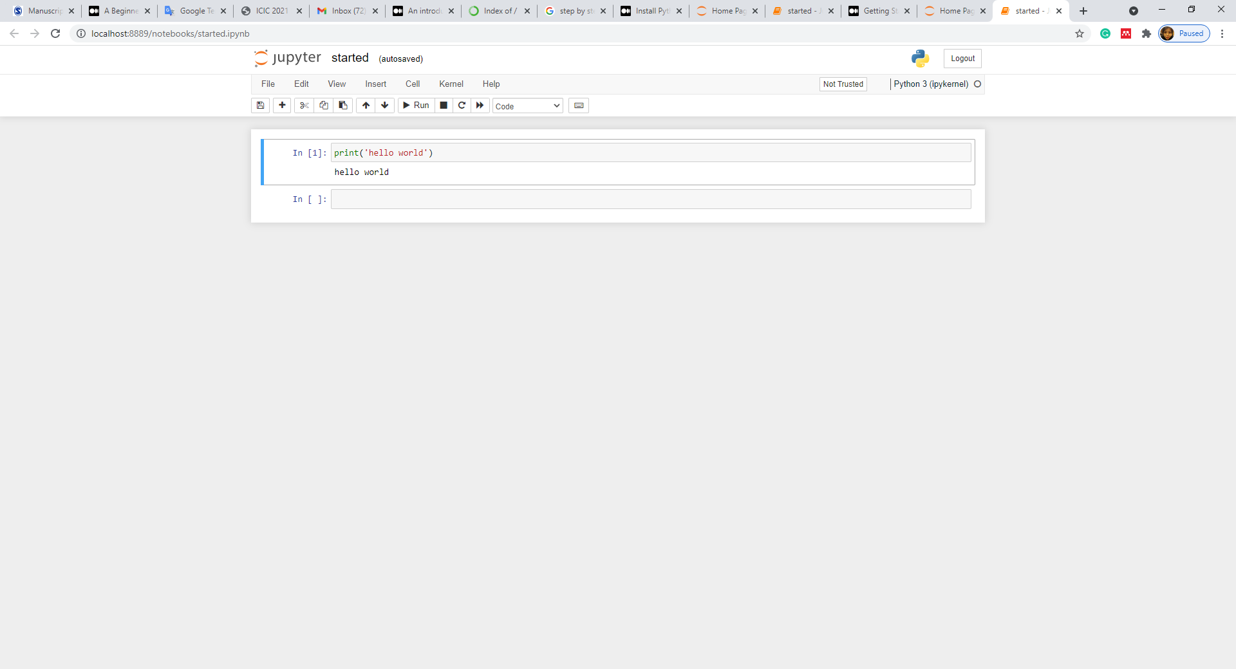

Slide 31
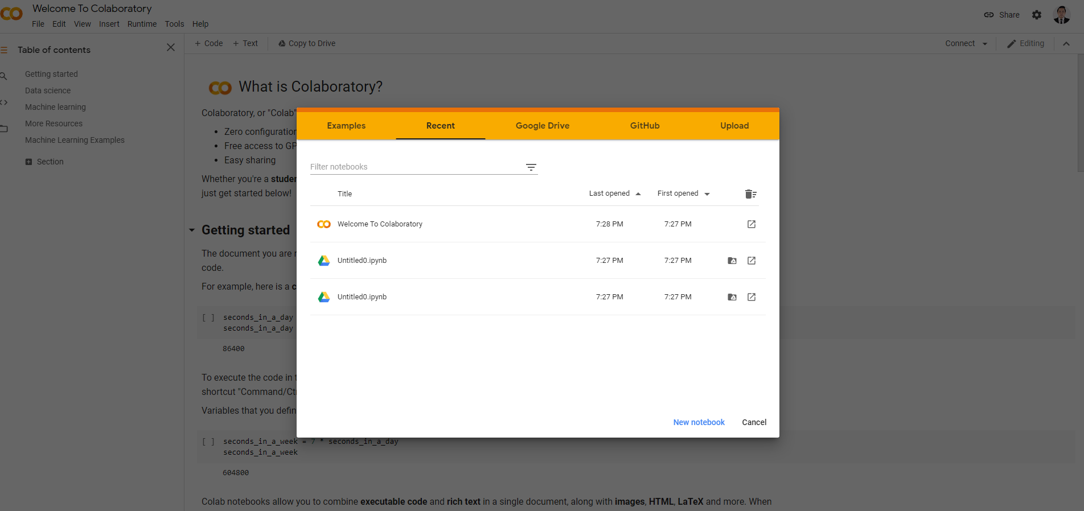
How to Install Anaconda, Jupyter Notebook, and Jupyter Notebook Online (google colab)
https://colab.research.google.com/

Slide 32
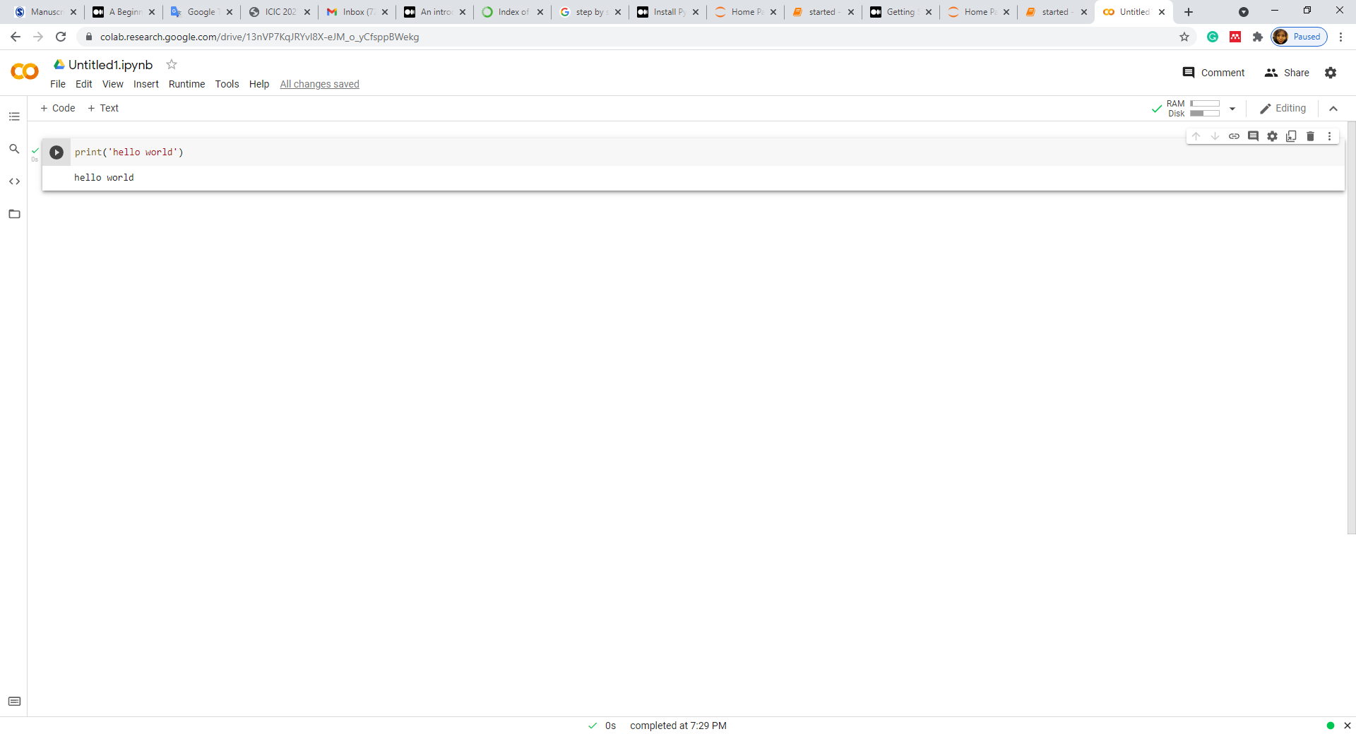
How to Install Anaconda, Jupyter Notebook, and Jupyter Notebook Online (google colab)

